Slide 1
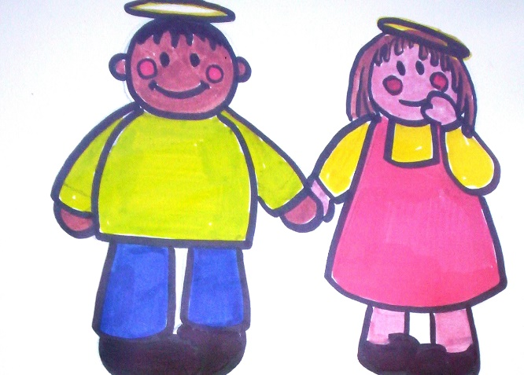
Little Saints
Welcome Meeting

Slide 2
Our Nursery
Dear Parents and Carers,
Welcome to our Nursery, we look forward to getting to know you and your child throughout your time with us. This power point will hopefully answer some of your questions about Nursery life but if you need to know more please do not hesitate to ask a member of Nursery staff. We aim to work in partnership with you to benefit the development of your child. We are sure your child will have a wonderful time with us.
Our Nursery sessions are:
AM - 8.30-11.30am
PM - 12.30pm-3.30pm

Slide 3
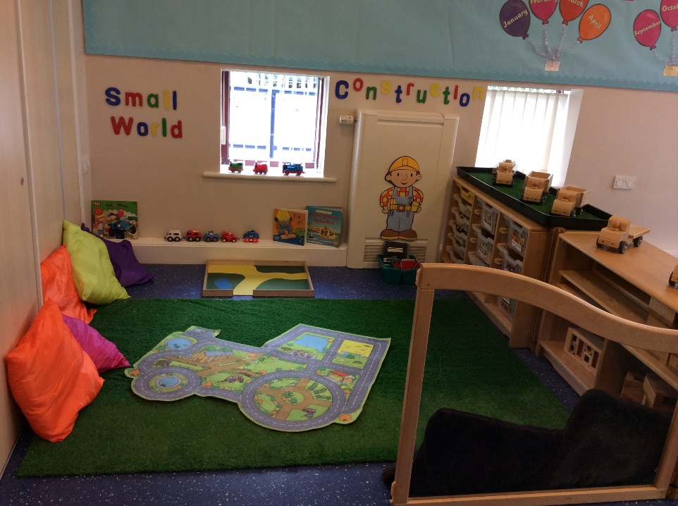
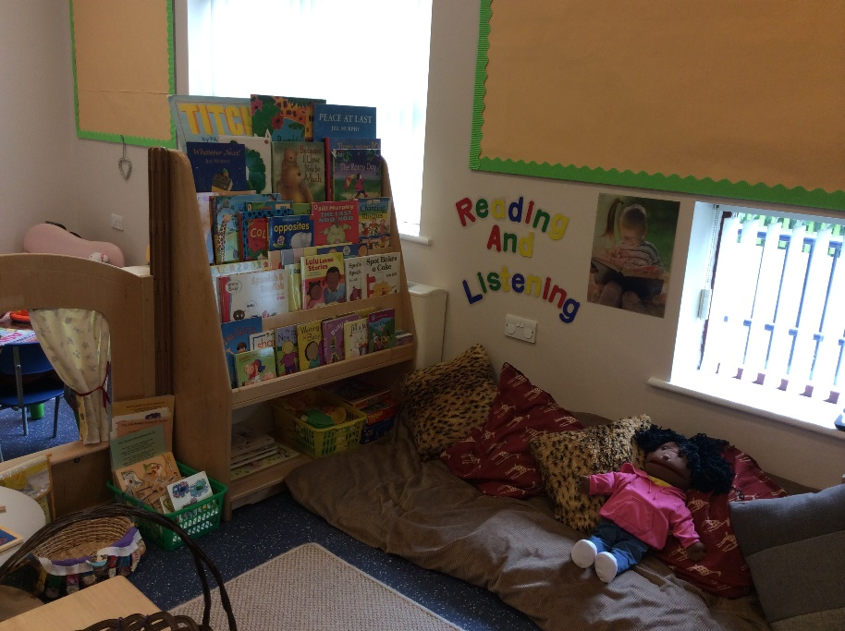
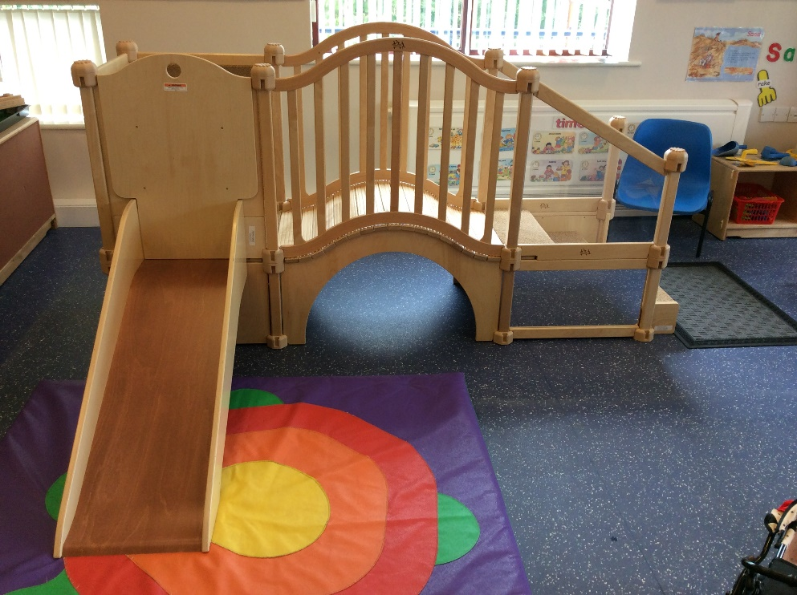
Indoors

Slide 4
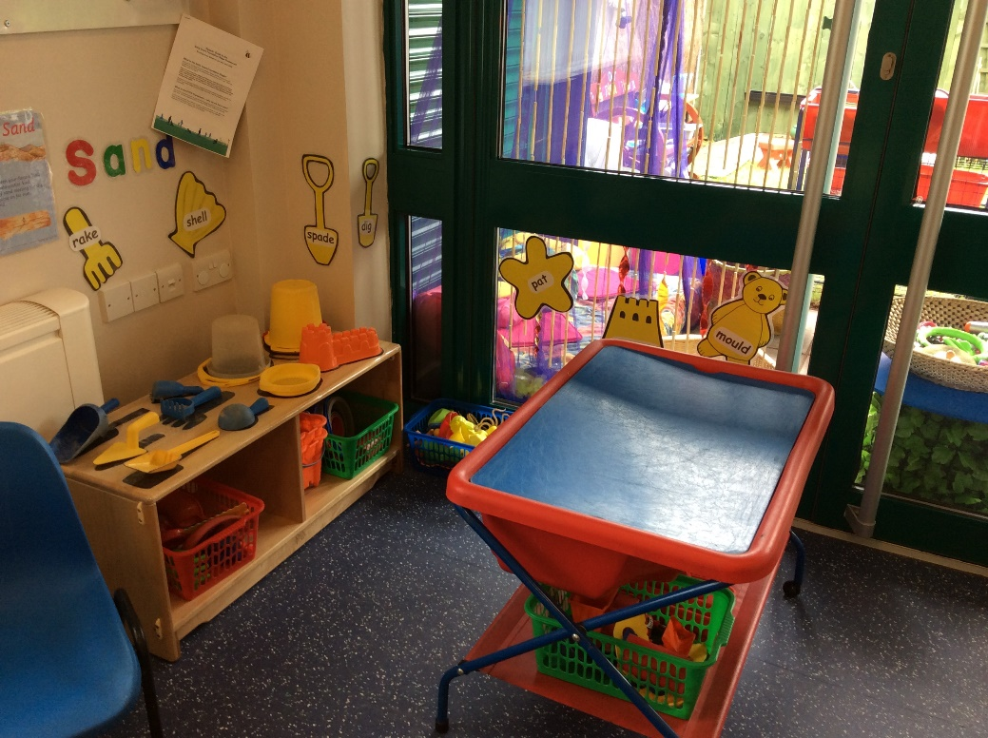
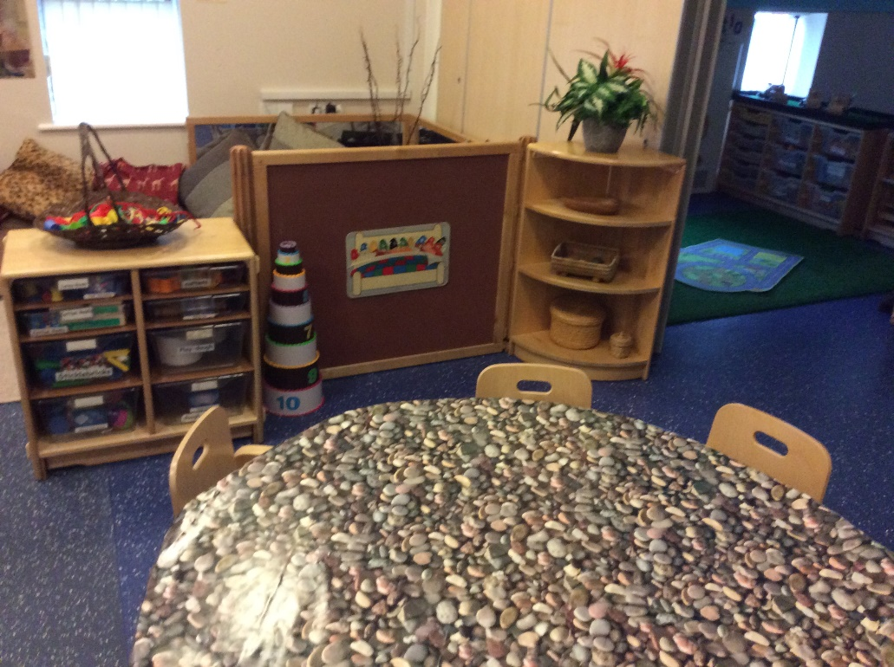
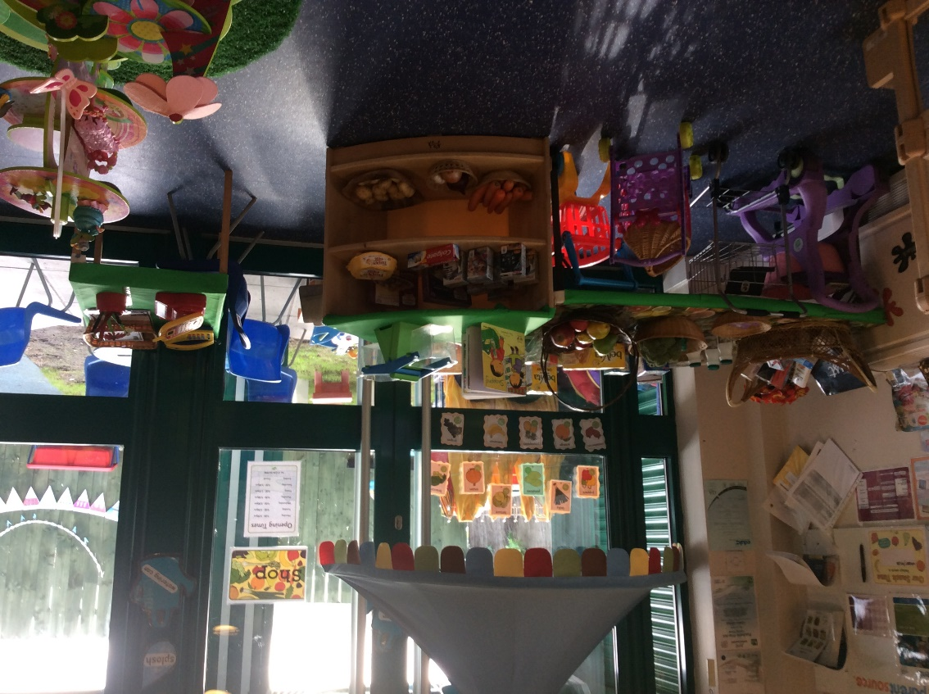

Slide 5
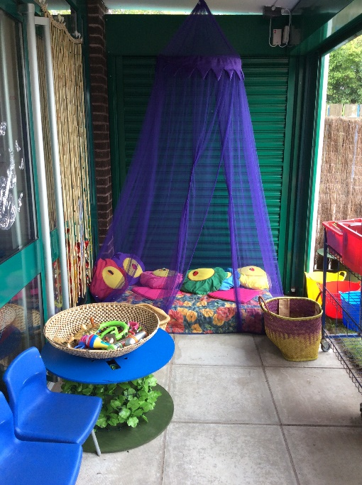
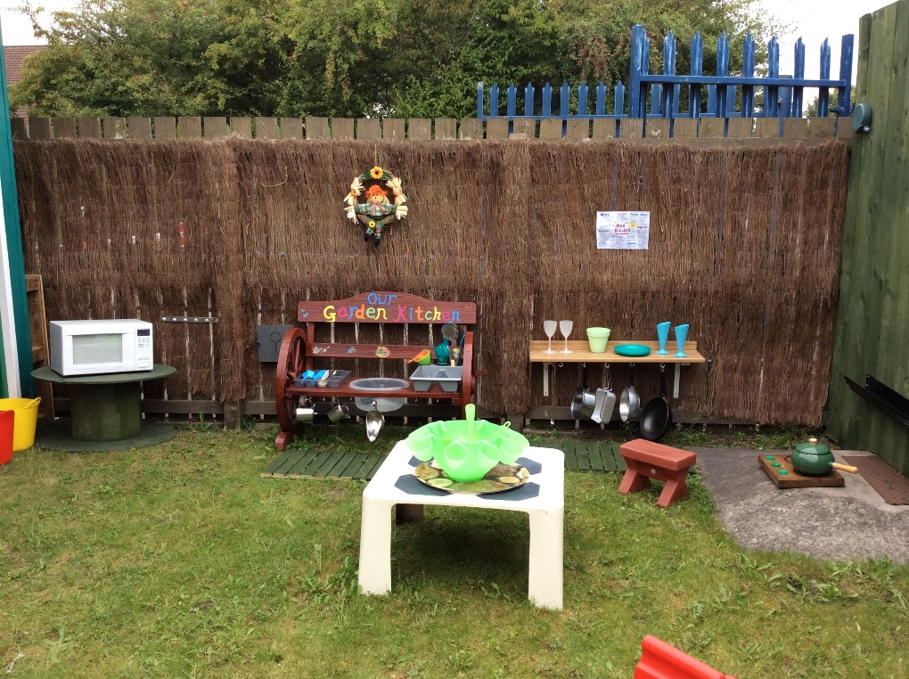
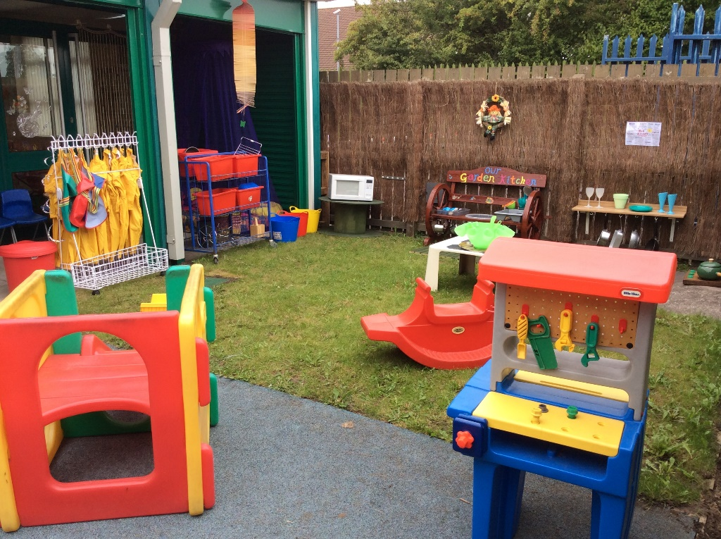
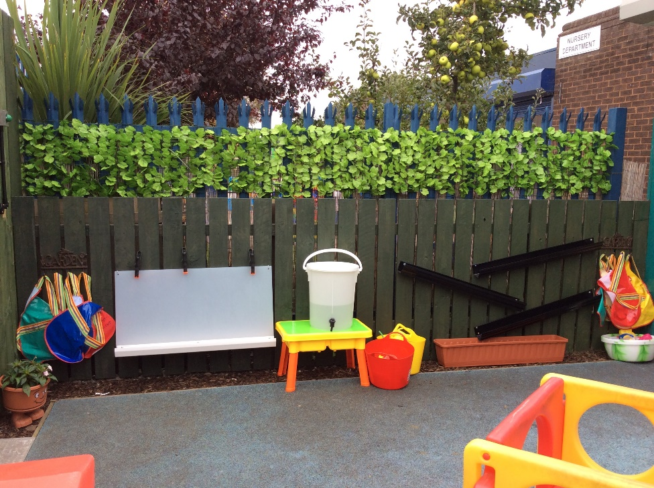

Slide 6
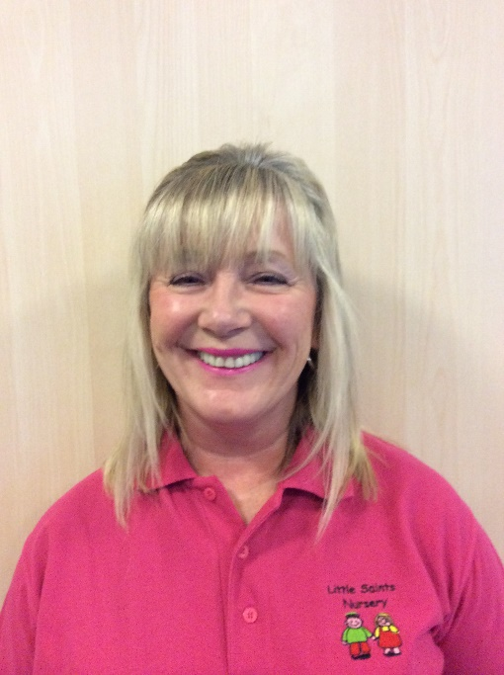
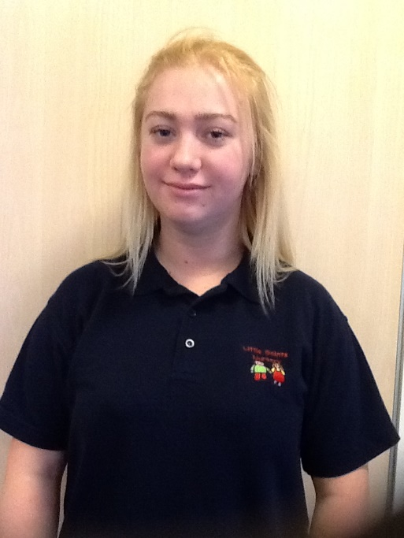
Our Staff Team
Lindsy Quigg
Manager
Sharon Walton
Deputy Manager
Courtney Miller
Teaching Assistant

Slide 7
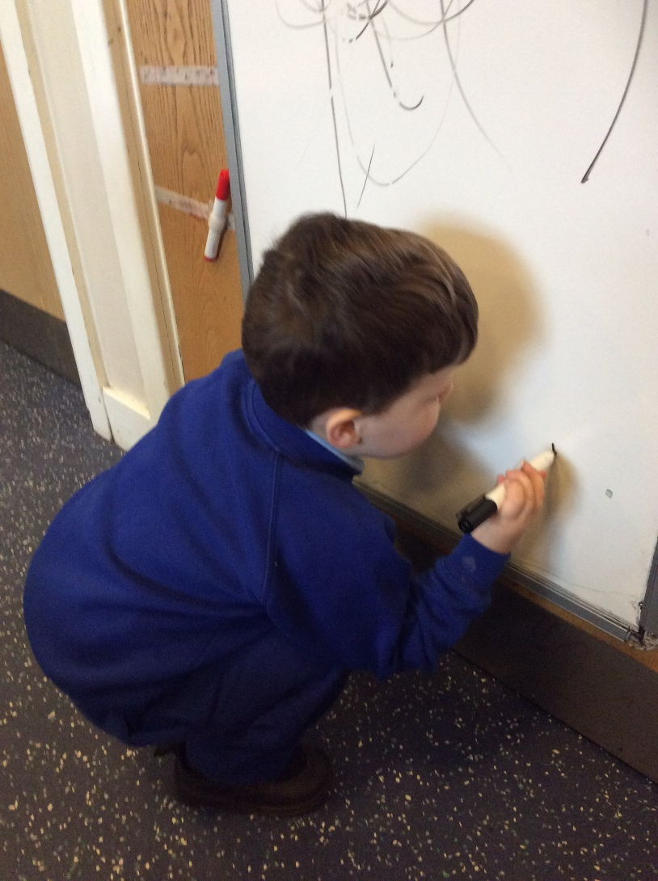
Uniform/Clothing

Slide 8
EYFS
In Nursery we use the ‘Early Years Foundation Stage Framework’ as guidance for our expectations of children – these are divided into 7 areas of Learning and we plan to ensure the environment, activities and experiences around them promote learning.
The 3 prime areas are:
Personal, Social and Emotional Development
Making friends, learning to share
Building confidence
Learning to follow routines and boundaries

Slide 9
Communication and Language
Listening & Attention; Can listen in small groups, showing attention, can join in with rhymes and songs
Understanding; instructions, who, what, where, why questions
Speaking; retelling a past event being able to explain, use new vocabulary,

Slide 10
Physical Development
Moving & Handling
Developing fine motor skills
Getting ready to write
Gross motor
Health & self care
Becoming independent; Putting own coat on, Washing hands independently

Slide 11
The 4 specific Areas are-
Mathematical Development; number, shape, space & measure
Literacy; Reading, writing
Understanding of the World; The world around them, family experiences, Technology
Expressive Arts and Design; singing, dancing, being imaginative, building or being creative
(You will receive a flyer each half term to let you know what your child will be doing in Nursery.)

Slide 12
Learning
Play is at the centre of learning for our children, sometimes it is a planned activity, sometimes the children will explore and initiate an activity. Through their play, we extend their learning; challenge and help develop an enthusiasm to learn.
In the early years, children develop rapidly and at different paces, we observe, keep records and assess children throughout their time with us in order to help them move on. We encourage children to feel secure and build on the knowledge and interests they already have.
If you have any concerns about your child’s development, please speak to us, we can seek support from other agencies if needed.

Slide 13
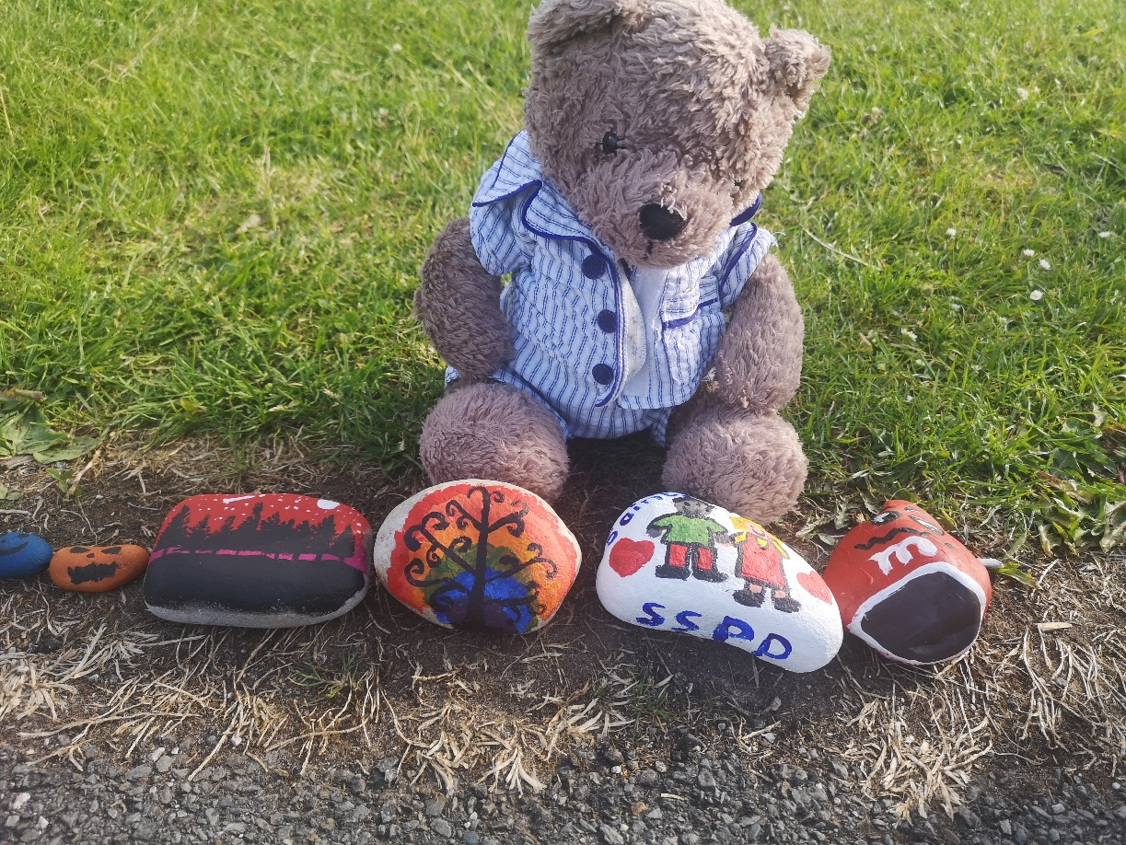
Fred the ted. Fred is our nursery bear, we take turns to take Fred home and he has a little diary that you can fill out to show us what you did with Fred, we share this with the other children before story time each day.
Home learning – your child will be given a home learning folder when they begin with us with a simple task to complete, we ask that you fill in a home learning story to let us know how they enjoyed each activity. You know your child best if you think that something is too difficult/easy or have any suggestions then please let us know.

Slide 14
Picking up your child
Little Saints children must be brought to and picked up from Nursery by an adult. They will not be allowed home with anyone under the age of sixteen.
We are vigilant on safeguarding your child and will only allow your child to go home with somebody that you have stated on the school permission form for pick up. In addition to this we would ask that you inform us who is picking your child up daily (if it is not you)
When your child begins with us you will be asked to provide a password (Favourite tv character/pets name etc.) that we can also ask the person you have told us is collecting them.

Slide 15
What you need to bring
A bag containing nappies, wipes and a change of clothes (Lots of changes if they are toilet training please)
A waterproof coat with a hood
A pair of wellies
A book bag (Available in the office)
A water bottle (with their name on, does not have to be a school water bottle but school do sell them)
Most importantly of all, please name all of your child’s clothing.

Slide 16
Toilet training
We will work with you when you think that your child is ready to begin toilet training. Once they begin we recommend that you use underwear (not pull ups) and provide plenty of changes of clothes as well as shoes (school PE shoes or doodles are great as they can be washed) and wipes .
We will work in partnership with you to support your child in toilet training, they must arrive in underwear.
We have some toilet training strategies and advice that we can give at the time.

Slide 17
Snack
Snack
Nursery children have a small snack each day; a charge of £1 per week is made for this. Please pay weekly or half-termly by placing the money in the money bag with your child’s name on. Snack includes milk, fruit, toast, crumpets, bread sticks and dips, sandwiches, yoghurts, crackers and cheese, biscuits. Please inform a member of staff if your child does not like milk or if your child has any allergies.

Slide 18
Absences/Illnesses
Absence
Please let us know if your child is likely to be absent for whatever reason.
If your child is ill, please keep them at home until they are well again. You can phone Little Saints (477 8207) or school (477 8205) to inform us that your child will be absent.
Medicines
Medicines should be given at home; staff cannot take responsibility for them. Inhalers will be administered to children with written permission from the parent/carer. Please can you bring your child’s Asthma card.

Slide 19
Settling your child in Nursery
In Little Saints there will be a transition period
First day will be 1 hour
We will gradually increase this time, this will depend on each individual child
Transition begins 10th September; Tuesday & Thursday
Unfortunately parents are not able to come into the nursery or stay at this time.

Slide 20
Once again “Welcome” to the Nursery, if you would like to know anything else about us, then feel free to email me or the school and I will try to answer any questions that you may have.
lindsy.quigg@saintspeterandpaulcps.org.uk
peterandpaul@knowsley.gov.uk
Thank you
Lindsy Quigg (Little Saints Manager)

