Slide 1
Welcome to Saints Peter and Paul
Nursery

Slide 2
Welcome to our Nursery
Dear Parents and Carers,
Welcome to our Nursery, we look forward to getting to know you and your child throughout your time with us. This power point will hopefully answer some of your questions about Nursery life but if you need to know more please do not hesitate to ask a member of Nursery staff. We aim to work in partnership with you to benefit the development of your child. We are sure your child will have a wonderful time with us.

Slide 3
CHILDREN’S MISSION STATEMENT
In our school:
We will work together, try our best and live as Jesus taught us by showing love, care and respect.

Slide 4
Staff in the Nursery
Nursery Teacher
Mrs Foot

Slide 5
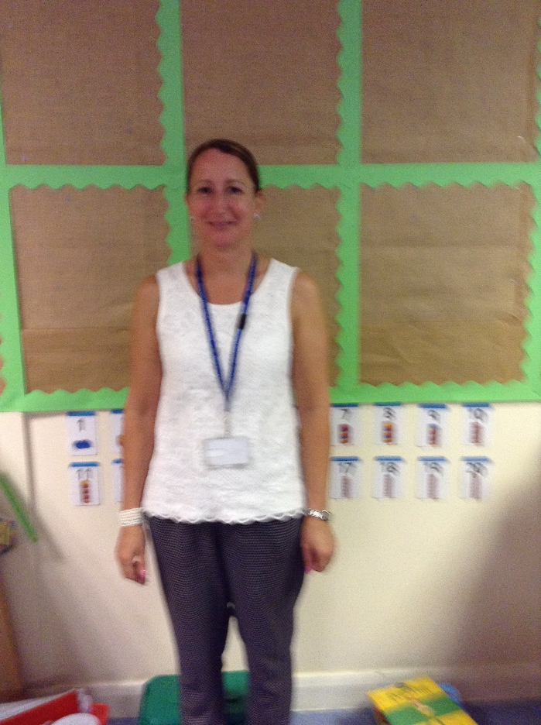
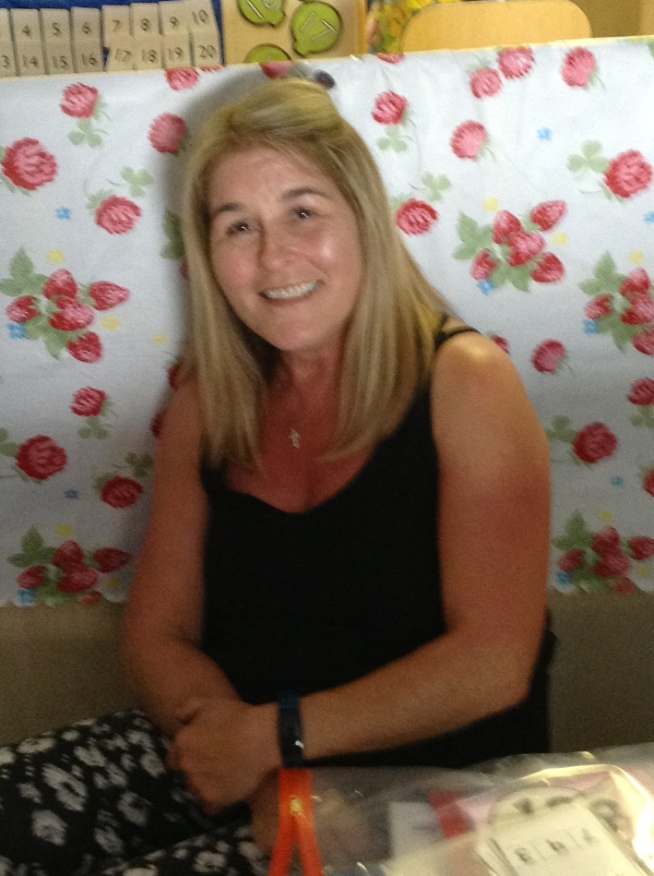
Mrs Radcliffe Miss Sultan Mrs Spinks

Slide 7
Times of Nursery:
Morning session: 8:30am-11:30 am
Afternoon session: 12.30pm-3.30pm
We also offer 30hours Nursery Education for those children that are
eligible. You can check if your child is eligible online; www.gov.uk/30-hours-free-childcare
30 Hours code.
You must ensure that your 30 hour code is submitted to the Admin Staff before the start of each new term.
There will be a weekly charge of £20 to cover the cost for the dinner ladies.

Slide 8
Picking up your child
Nursery children must be brought to and picked up from Nursery by an adult. They will not be allowed home with anyone under the age of sixteen.
We are vigilant on safeguarding your child and will only allow your child to go home with somebody that you have stated on the school permission form for pick up. In addition to this we would ask that you inform us who is picking your child up daily (if it is not you)

Slide 9
Nursery Uniform
Boys
Saints Peter and Paul Blue tracksuit with blue polo t-shirt
Or Saints Peter and Paul Sweatshirt, with blue polo t-shirt and grey trousers/shorts
Velcro strap shoes/trainers
Girls
Saints Peter and Paul blue cardigan, with blue polo t-shirt and grey slip or skirt
Or blue and white check summer dress
white socks
Blue/white hair accessories (No big bows)
Velcro strap shoes/trainers

Slide 10
Nursery Uniform

Slide 11
Must haves!
A waterproof coat with a hood
.A pair of wellies.
.A book bag
.A water bottle (with their name on, does not have to be a school water bottle)
.A bag with a change of underwear, including socks and a change of clothes (this does not need to be uniform, it can be leggings/t-shirt)
Most importantly of all, please name all of your child’s clothing
especially their coat this makes it much easier for us at home time.

Slide 12
Snack/food in Nursery
Snack
Nursery children have a small snack each day; a charge of £1 per week is made for this. Please pay weekly or half-termly by placing the money in the money bag with your child’s name on. Snack includes milk, fruit, toast, crumpets, bread sticks and dips, sandwiches, yoghurts, crackers and cheese, biscuits. Please inform a member of staff if your child does not like milk or if your child has any allergies.
Lunch (for 30hours children only)
You will need to provide a packed lunch for your child.
A Healthy packed Lunch Leaflet will be provided to give advice on what to give your child.
Or a school hot dinner can be provided for a small charge

Slide 13
Absence/illness
Absence
Please let us know if your child is likely to be absent for whatever reason.
If your child is ill, please keep them at home until they are well again. You can phone school (477 8205) to inform the office that your child will be absent.
Medicines
Medicines should be given at home; staff cannot take responsibility for them. Inhalers will be administered to children with written permission from the parent/carer. Please can you bring your child’s Asthma card.

Slide 14
Curriculum
In Nursery we use the ‘Early Years Foundation Stage Framework’ as guidance for our expectations of children – these are divided into 7 areas of Learning and we plan to ensure the environment, activities and experiences around them promote learning.
The 3 prime areas are:
Personal, Social and Emotional Development
Making friends, learning to share
Building confidence
Learning to follow routines and boundaries

Slide 15
Communication and Language
Listening & Attention; Can listen in small groups, showing attention, can join in with rhymes and songs
Understanding; instructions, who, what, where, why questions
Speaking; retelling a past event being able to explain, use new vocabulary,

Slide 16
Physical Development
Moving & Handling
Developing fine motor skills
Getting ready to write
Gross motor
Health & self care
Becoming independent; Putting own coat on, Washing hands independently

Slide 17
The 4 specific Areas are-
Mathematical Development; number, shape, space & measure
Literacy; Reading, writing
Understanding of the World; The world around them, family experiences, Technology
Expressive Arts and Design; singing, dancing, being imaginative, building or being creative
(You will receive a flyer each half term to let you know what your child will be doing in Nursery.)

Slide 18
Learning
Play is at the centre of learning for our children, sometimes it is a planned activity, sometimes the children will explore and initiate an activity. Through their play, we extend their learning; challenge and help develop an enthusiasm to learn.
In the early years, children develop rapidly and at different paces, we observe, keep records and assess children throughout their time with us in order to help them move on. We encourage children to feel secure and build on the knowledge and interests they already have.

Slide 19
Toileting
By the time children start nursery, it is our school policy that the children must be toilet trained. If your child is not toilet trained, please feel free to speak to a member of staff for useful strategies to use before they start. Unfortunately, we cannot take responsibility for toilet training your child.
If your child has specific medical needs and struggles with toilet training, we will again work with you to introduce strategies when your child is ready and will seek advice from outside agencies to help us work together to meet your child’s needs.

Slide 20
Settling your child in Nursery
In Nursery there will be a transition period
First day will be 1 hour
We will gradually increase this time, this will depend on each individual child
30 hour children – usually 2 weeks
Week of 14th September; Tuesday & Thursday

Slide 21
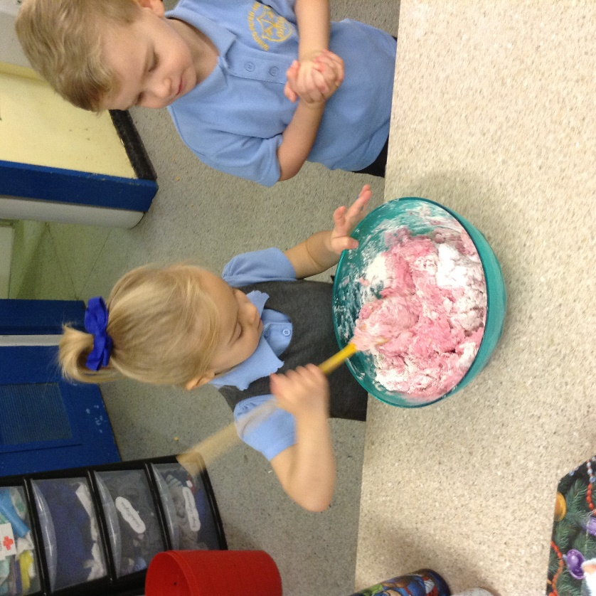
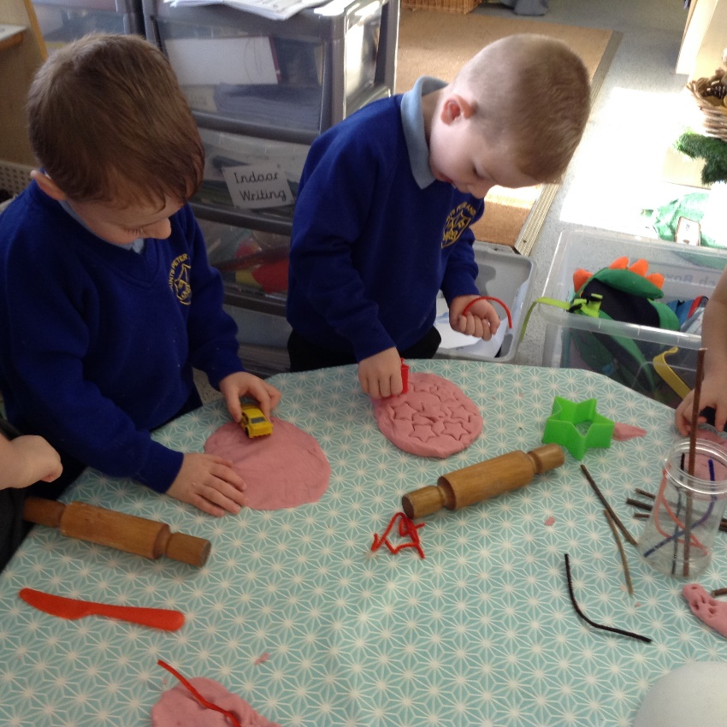
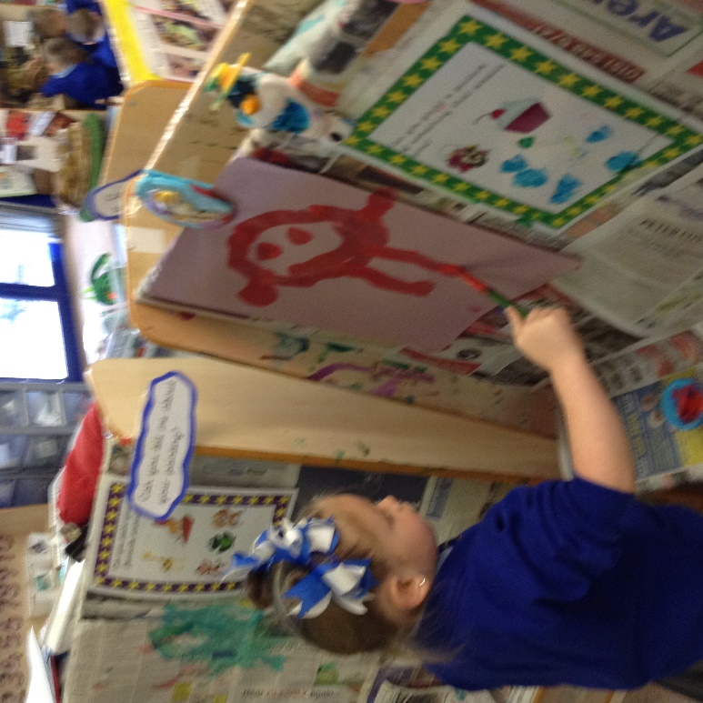
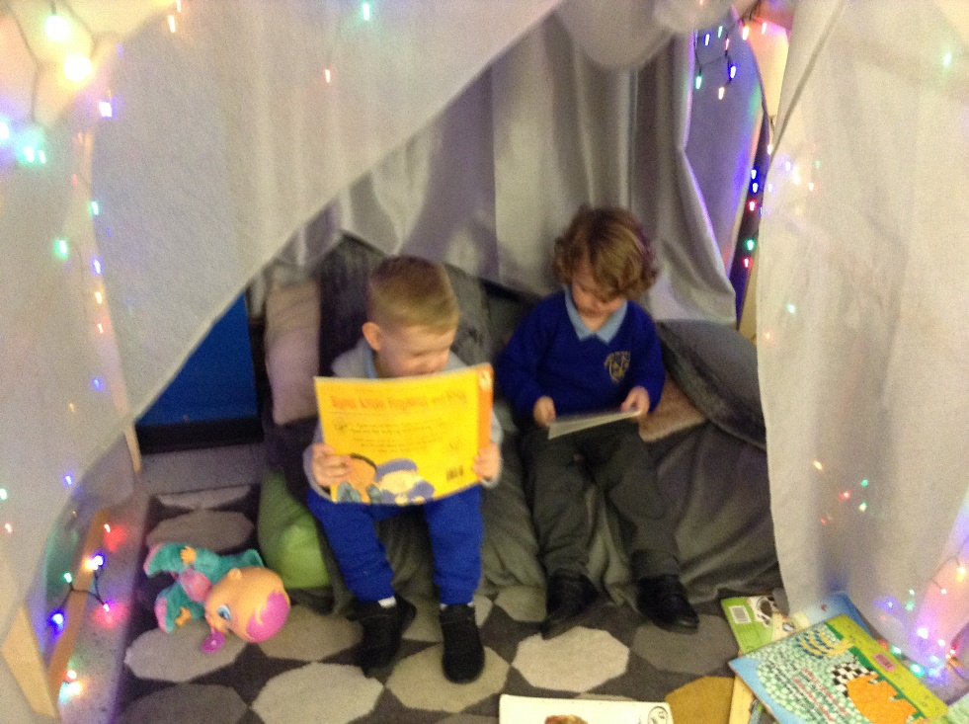
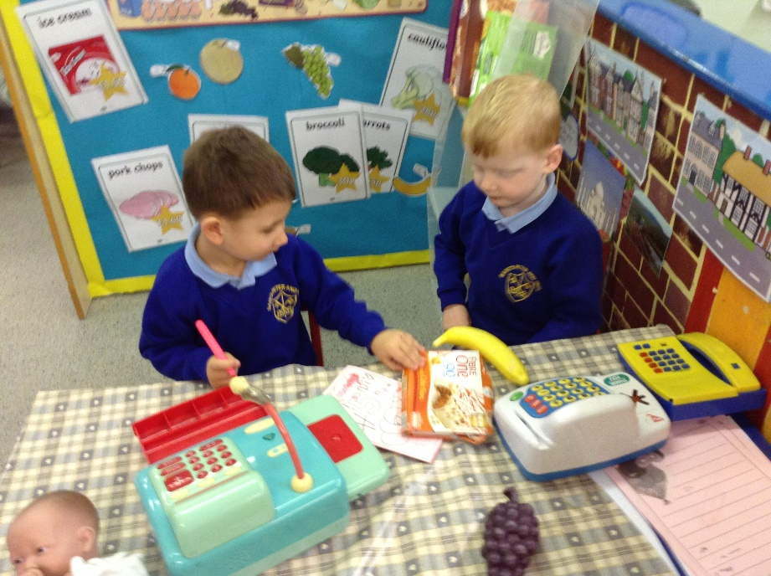
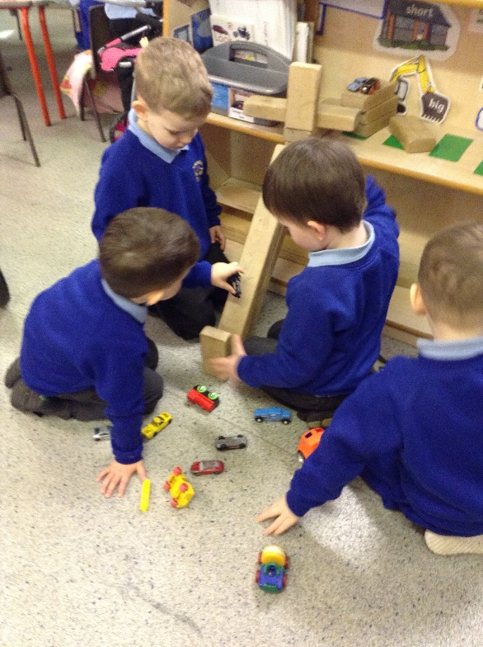

Slide 22
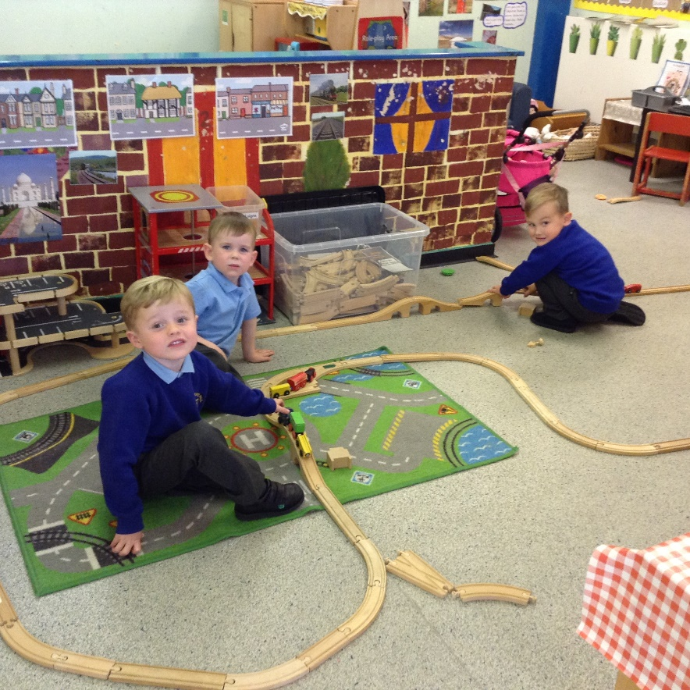
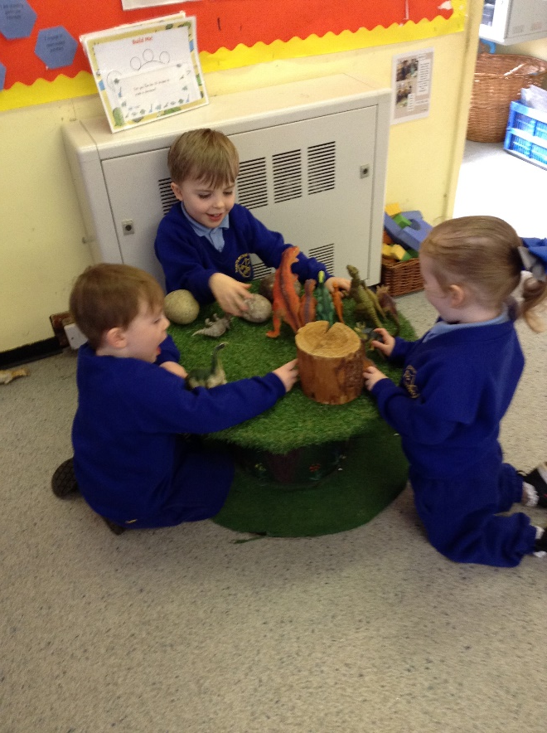
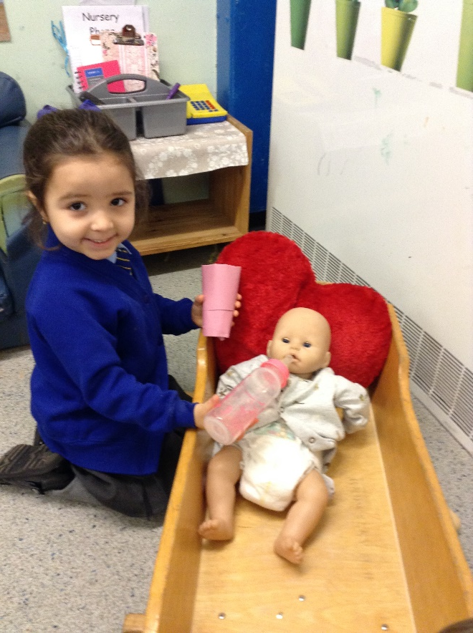

Slide 23
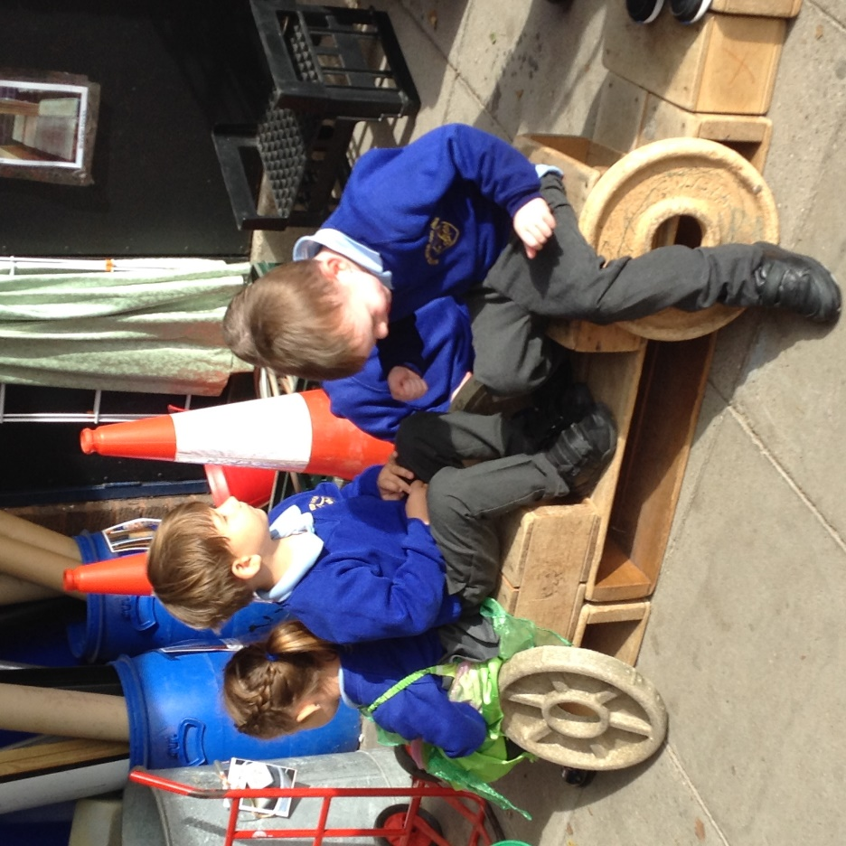
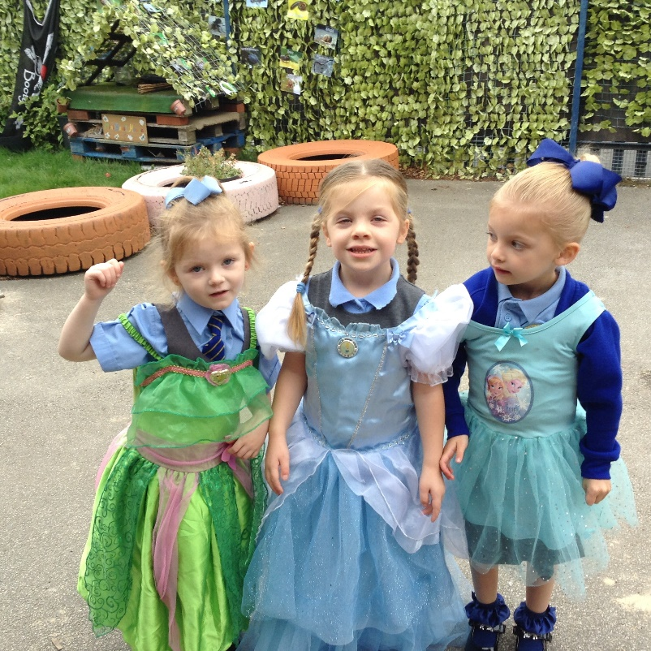
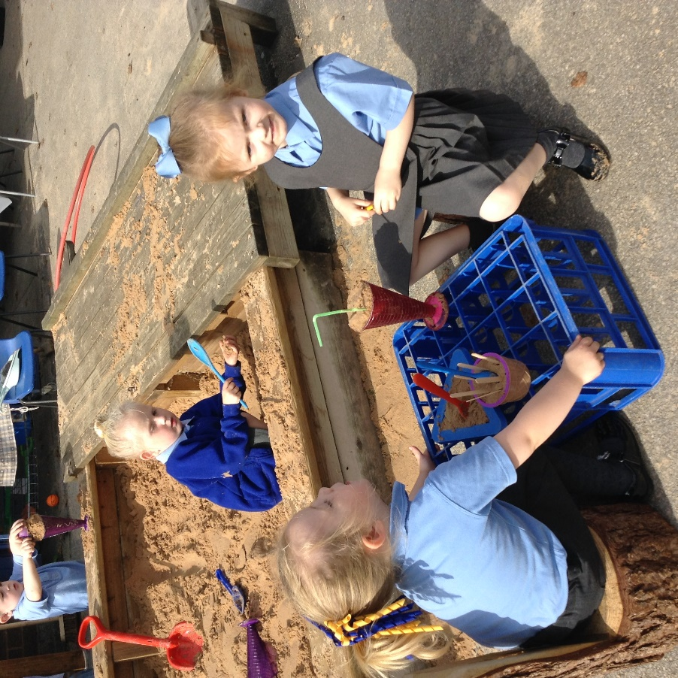

Slide 24
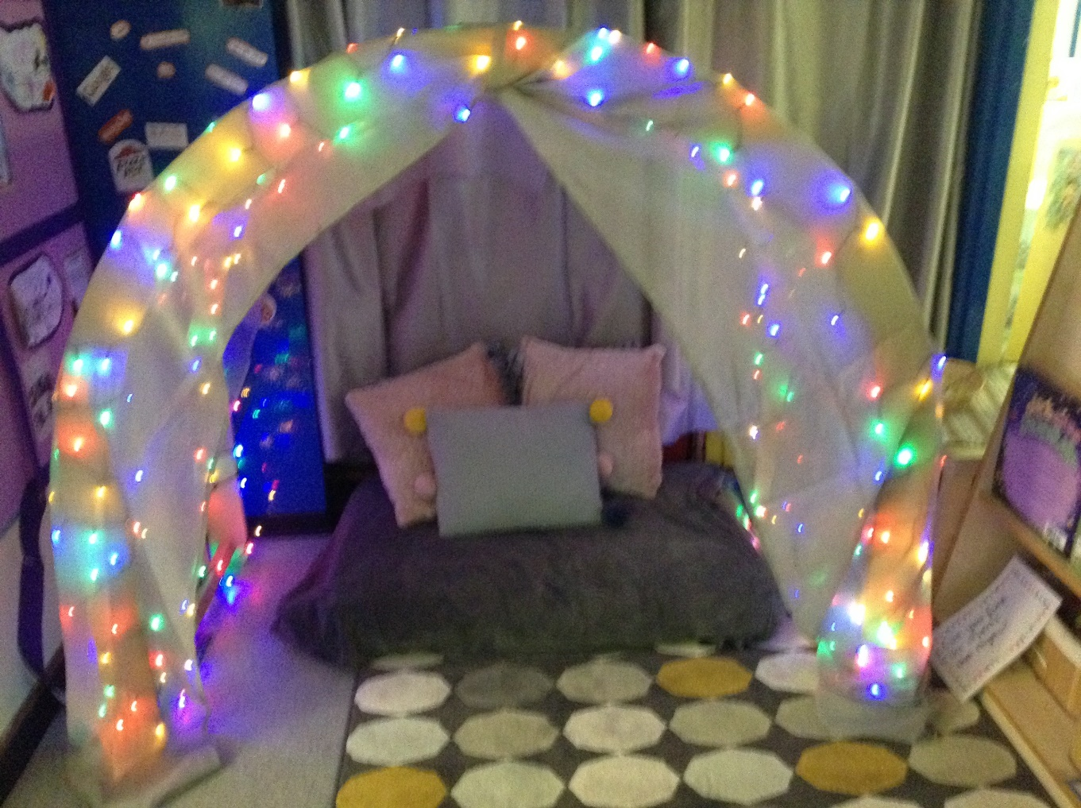
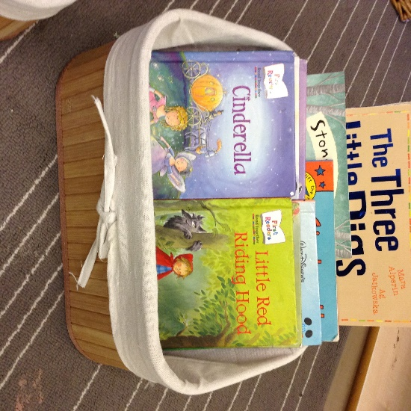
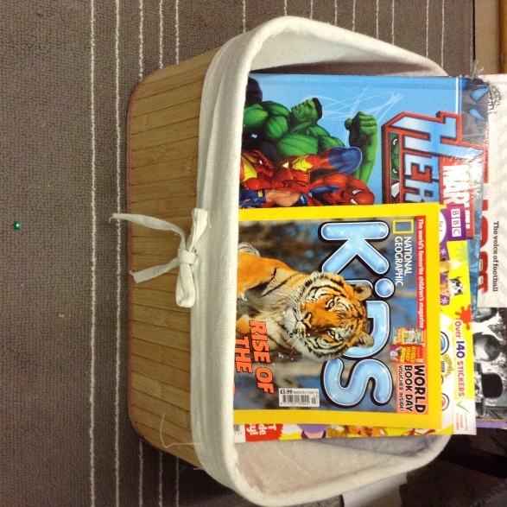
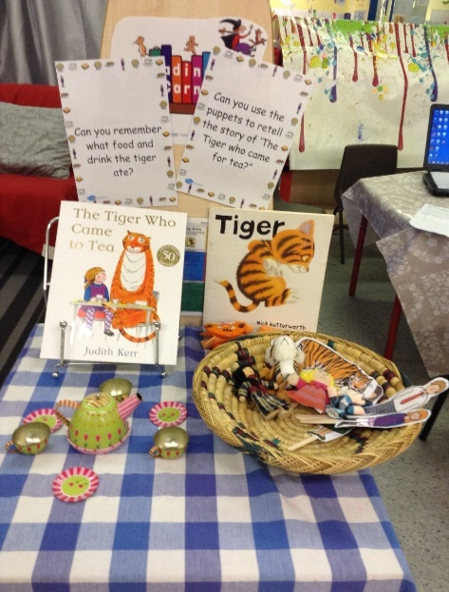
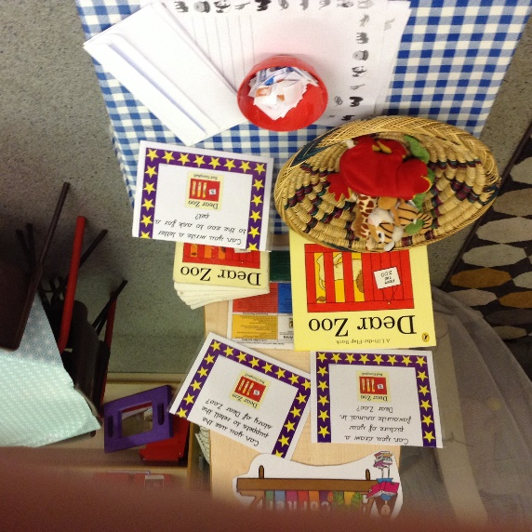
Reading Area

Slide 25
Once again “Welcome” to the Nursery, if you would like to know anything else about us, then feel free to email school and I will try to answer any questions that you may have.
peterandpaul@knowsley.gov.uk
Thank you
Mrs Foot (Nursery Teacher)

