Slide 1
Reception age appropriate texts

Slide 4
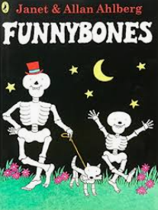
Year 1 age appropriate texts

Slide 8
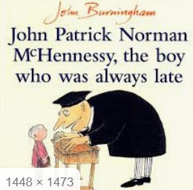
Year 2 age appropriate texts

Slide 9
Year 3 age appropriate texts

Slide 11
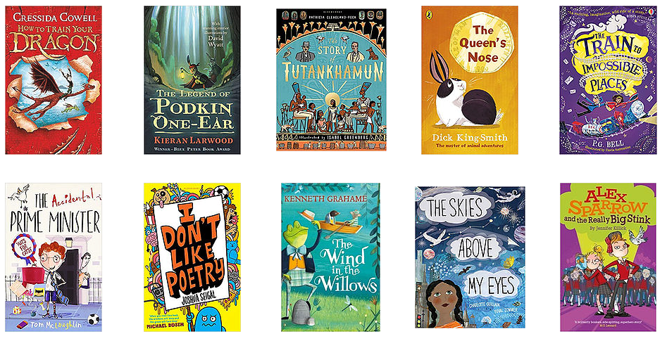
Year 4 age appropriate texts

Slide 13
Year 5 age appropriate texts

Slide 15
Year 6 age appropriate texts

Slide 18
Recommended reads!
Younger readers!
older readers!

